Slide 1
Sponsorship & Exhibition Pack

Slide 2
Introducing the 2024 Conference
Theme: The Science and Perception of Skin Ageing - Well-Ageing and Longevity
Get ready to explore the captivating world of the science and perception of healthy skin ageing and longevity at the 2024 conference. This exciting event will unravel the facts and perceptions around skin ageing while exploring the connections between health and skin ageing, longevity and the quest for timeless skin beauty.
The conference promises to reveal insights into effective preventative and functional skincare strategies; sparking innovative ideas to emerge and pave the way for new product development concepts.

Slide 3
Our goal is to enhance your understanding of the state-of-the-art science and thinking in this space through four in-depth sessions:
S1: What is Healthy Skin Ageing: Discover the processes and factors influencing healthy skin ageing and the mechanisms by which these shape our appearance, relate to the health of our body and endure over time.
S2: Achieving Healthy Skin - Technological Approaches to Well-Ageing: Navigate a world of new active ingredients and concepts, backed by the latest science and detailed mode-of-action studies that support their benefits and claims.
S3: Assessing Skincare Benefits and Advertising Claims: Dive into diagnostics and efficacy testing methods as they relate to the assessment of healthy skin ageing, gaining insights that guide informed decisions in clinical and in vitro studies, as well as advertising claims
S4: A Future View of Well-Ageing: Peer over the horizon to where science, consumer perceptions and insights converge and see how these are shaping the future of well-ageing (healthy ageing) skincare.

Slide 4
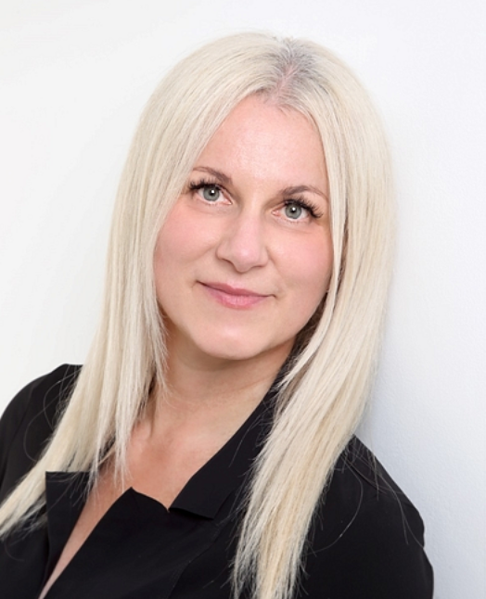
Scientific Programme Director
Dr Katerina Steventon
Dr Katerina Steventon is a skincare specialist with substantial experience of working at the clinical, commercial and research interface. She holds an MSc in Clinical Biochemistry, a PhD in Transdermal Absorptions and has over 25 years’ global work experience in the personal care and wound care industry. Katerina has an in-depth knowledge of skin biology, skin health and ageing as well as front end innovation and translational research engaging industry and academia. Having lived and worked around the world, she understands the consumer paradigm and perceptions of skincare across different cultures and ethnicities and runs an innovation consultancy focussing on functional skincare.

Slide 5
WHO ATTENDS?
See below for a preview of job titles and companies that have attended the Anti-Ageing Conference:
Director of Science
Director Strategic Innovation & Science
Formulation Scientist
Head of Development & Compliance
Head of Skincare
Head of Skin Lab
Innovation Skincare Technologist
Product Manager
Project Manager
R&D Director
R&D Manager
Regulatory Affairs Manager
Regulatory Manager
Scientific Expert
Scientific Vice President
Technical Directors

Slide 6
WHY SPONSOR?
What sets us apart….. Previous sponsors have included:
DELEGATES
Approximately 130– 150 Leading Technicians,
Scientists and Heads of R&D from major skincare
brands all over the world.
NETWORKING Networking social functions are a key part of the
experience, the environment encourages closer
rapport to develop between all participants
CONTACT INFORMATION
We provide you with contact details of all the
event participants after the conference has
concluded. MARKETING FEATURES Your logo and website link will feature on all
Anti-Ageing marketing mailers sent by Summit
Events. Plus, your logo will feature on the official
conference programme issued to all delegates at
the conference. An announcement about your
company emailed to our database of over 40,000
contacts! - includes 200 words copy, logo and
web link (offered to gold/platinum packages only) A SUPPORTIVE PROCESS we will always be on hand to ensure your time is
well spent. We will do our best to facilitate meetings
with delegates.

Slide 7
Exhibition & Sponsorship Packages
Exhibition space A 2m x2m exhibition space – 2 chairs, 1 trestle table and power supply. Roller banners and/or portal displays must be provided by you and must fit within the dimensions of the space. Entrance to the networking breaks – please note, this does not include entrance to the speaker sessions. | Prices from: £2,800 + VAT
Silver sponsorship package A 2m x 2m exhibition space Full access to the conference Insert in conference bags/ seat drop (subject to availability) Half page full colour advert Branding on our website and marketing mailers | Prices from: £3,900 + VAT
Gold sponsorship package A 2m x 2m exhibition space 2 tickets to the conference Half page full colour advert Branding on our website and marketing mailers Your logo / video to be played on stage screen between speakers and during breaks (once on each day) X1 A4 colour advert in the event programme Option of one of the following sponsorship options: please refer to the next page for sponsorship options | Prices from: £5,500 + VAT
Platinum sponsorship package - Official event sponsor + one additional branding opportunity A 2m x2m exhibition space 3 tickets to the conference Branding on all physical and digital marketing materials – with elevated positioning Brochure or insert in the conference bag X1 A4 colour advert in the event programme 2 self standing banners displayed for the entire two days Your logo in prime position on two Summit Events welcome banners Your logo on the front cover of the conference programme Your logo on the opening presentation slide Your logo listed on the event website and monthly marketing mailers as the official conference sponsor Social media announcement across LinkedIn Option of one of the following sponsorship options: please refer to the next page for sponsorship options | Prices from: £7,700 + VAT

Slide 8
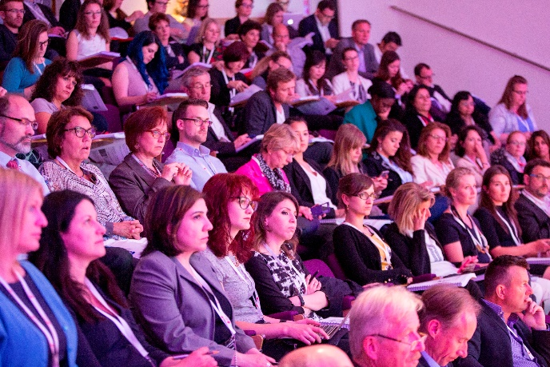
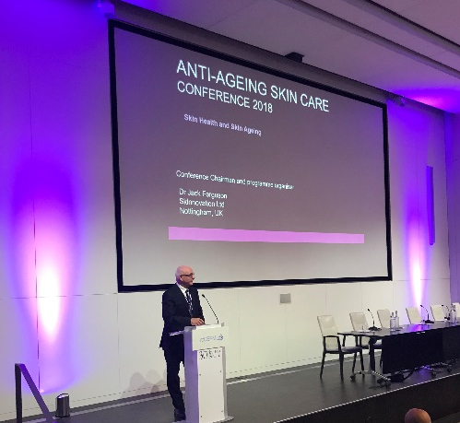
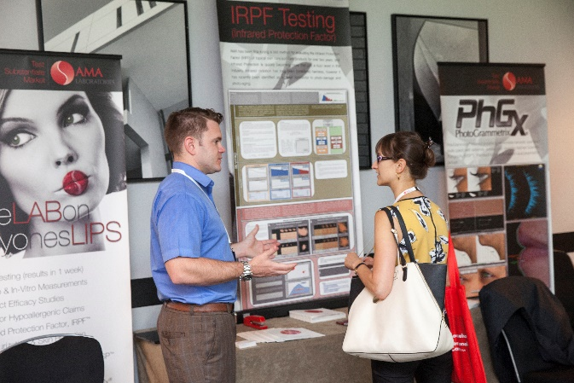
Other sponsorship options
Our sponsorship packages are a proven way to increase your exposure at the conference. You will benefit from being able to promote your brand to all event participants. It’s particularly effective if you wish to launch or promote new services or products at the conference.
Packages are subject to availability and include:
Accessories sponsor– please contact a member of the team to discuss possible accessories sponsors (subject to approval). | £1200
Conference bags sponsor – Your colour logo printed on the front of the conference bags which are given to all participants on registration and 1x insert or gift in each bag (subject to approval). | £1500
Badge & Lanyard sponsor – Your company logo branded on the name badge & lanyards | £1500
Drinks reception sponsor - Your corporate branding prominently displayed in the drinks reception area with company literature and a self-standing banner (provided by you). | £1200
Insert in event bags/ Seat drop - 1 x brochure, flyer or gift (subject to approval). | £800
Pads and pens sponsor - Your pad and pens in all the participants bags and main plenary room. | £600

Slide 9
BOOK NOW!
Exhibitor and sponsor places are limited – please get in contact with the team to reserve your place!
Your company logo and web link will be published immediately on the Summit Events website
Your company name, and link to your website will be announced on our LinkedIn group!
Your company will be publicised in our monthly mailers to our database
Get in touch now to reserve your place!
Call on: +44 20 7828 2278 or email: eventteam@summit-events.com
Visit our website here to find out more!

