Slide 1



EVIDENCE BASED COSMETICS
From culture dish to pre-clinical
for predicting clinical results.
Dr. Claire LEDUC (SYNTIVIA, Toulouse)
Dr. Karl LINTNER (KAL’IDEES, Paris)

Slide 2

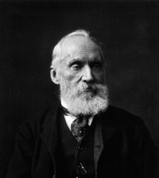

Lord Kelvin
(1824-1907)
To measure is to know!
(anything else is philosophy)

Slide 3



ἓν οἶδα ὅτι οὐδὲν οἶδα"
Scio me nihil scire

Slide 4
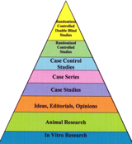
Science or Evidence?
Evidence:
  = Claim substantiation: sufficient,
  credible proof that what we say is true
Science:
  = A desire to understand underlying principles, to build theories with
  predictive power

Slide 5
WHY DO WE NEED THIS « EVIDENCE »?
FDA?
FTC
EU Regulation
Korean Functional Cosmetics
Japanese Quasi Drugs
QVC, Teleshopping et al.
Consumers, NGOs and competitors
5

Slide 6

INTERFACE OF SCIENCES IN ORDER TO: FORMULATE, CLAIM, PROVE!
6

Slide 7
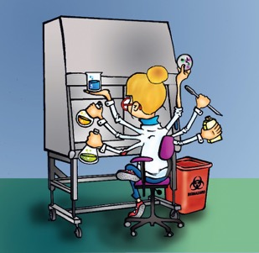
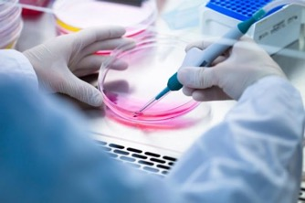
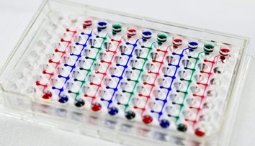
Measuring “anti-ageing” effects
in cell culture protocols
7

Slide 8
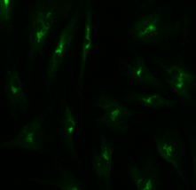
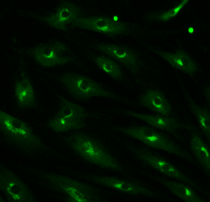
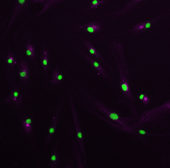
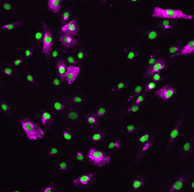
Protein synthesis stimulation
Monolayer cell culture:
Extrapolation to clinical data?
Untreated
Treated
***
Klotho
**
Collagen 1
Notes:
Quantification of 2 anti-aging proteins after treatement with active molecules by automated microscopy:
Klotho in the endoplasmic reticulum (green)
Collagen 1 in the cytoplasm (pink)

Slide 9
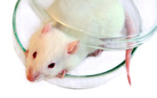
In vitro and in vivo:
not enough
In vitro: enzymatics, cell culture, microscopy, DNA array, PCR, ELISA, HPLC…
The GAP is too great for extrapolation
In vivo (clinicals): dermatological assessment, instrumental analysis, use tests, sensorial analysis…
9

Slide 10
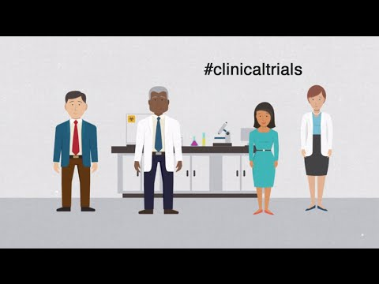
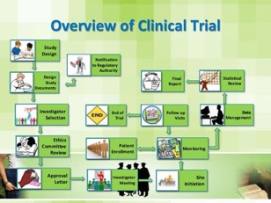


Clinical testing: expensive

Slide 11
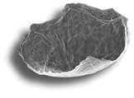
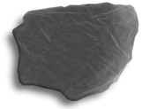




Measuring ”anti-ageing” performance?
Quantitatively?
Skin hydration state
Wrinkle depth, volume, density, isotropy, roughness…
Skin elasticity
Wrinkle surface
Wrinkle volume
Surface accidents
11

Slide 12
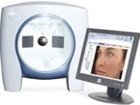
Wrinkles
The VISIA® system and its data base (≈3500 women) allows us to determine
the « mean theoretical age » of the skin
12

Slide 13
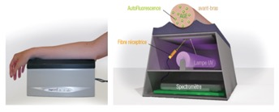
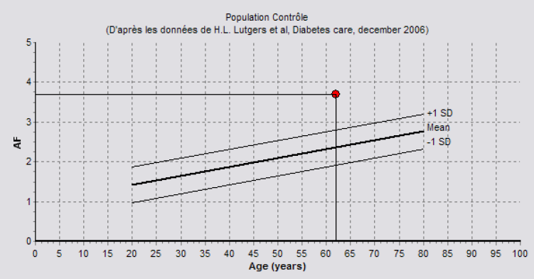
Skin glycation = f(age)
AGE-Reader®
Correlation Age – AGEs autofluorescence
13

Slide 14
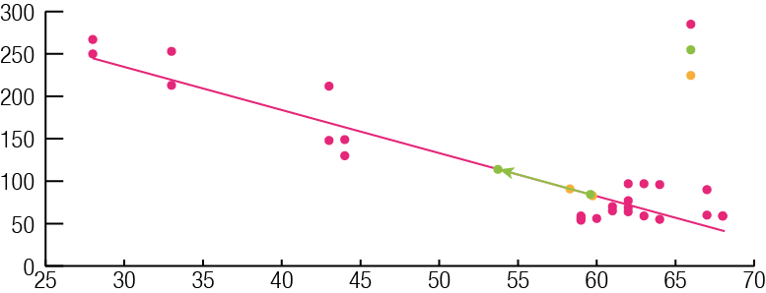
Skin viscosity = f(age)
Preliminary study carried out by Sederma
Reviscometer®
Average RRT (ms)
« Minus six years
in 1 month »
Age
14

Slide 15
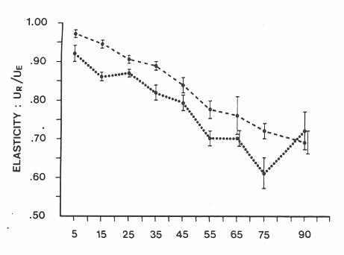
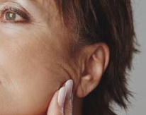
Skin elasticity = f(age)
Correlation Resistence R25/age (arm)
20,00
18,00
16,00
y = -0,161x + 15,325
14,00
R
2
= 0,5629
12,00
10,00
8,00
6,00
4,00
2,00
0,00
20
30
40
50
60
70
80
Age
Skinflex®
Cutometer®
15

Slide 16
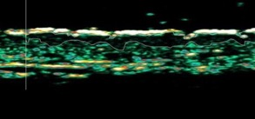
Skin density (SLEB) = f(age)
SLEB is the Subepidermal Low Echogenic Band observed by echography.
SLEB
SLEB thickness (µm) versus age
350
y = 5,0377x
-
62,044
300
250
SLEB thickness (µm)
200
150
100
50
0
0
10
20
30
40
50
60
70
80
AGE
Querleux B, Baldeweck T, Diridollou S, et al. Skin from various ethnic origins and aging: an in vivo cross-sectional multimodality imaging study. Skin Res Technol. 2009;15(3):306-313. doi:10.1111/j.1600-0846.2009.00365.x
16

Slide 17
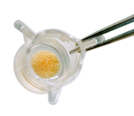
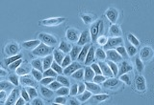
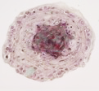
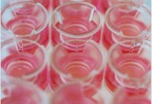
IN VITRO - EX VIVO SKIN MODELS
Cells in 2D culture
Microtissus
Cells in 3D culture
Reconstructed skin
Skin Explants
Proximity to in vivo
Notes:
Increasingly complex models that are more and more representative of the response of human skin

Slide 18
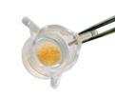

A COMPLETE STUDY
External stress
Fibroblasts
Keratinocytes
Melanocytes
Sebocytes
others…
Skin Explant
Cell culture
Molecular biology & Screening
Protein activity
& Screening
Functional analysis
Skin biomarkers activation
Structural analysis
Identification of actives products
Validation of metabolic pathways
To deepen the mode of action
Validation on the skin before clinic
+ Imaging
Notes:
The scientific path
A complete study can implement all of the models presented
The path is not necessary in a straight line but can go backwards to better start again towards more complex models.
Focus on the Skin explant models modified by artificial ageing .
It is the response of this type of model that will serenely lead us to clinical studies.

Slide 19
ANTI-AGEING SKIN MODELS
We use skin explants that we age artificially
to accelerate and mimic natural ageing.
Alteration of the
dermal-epidermal junction
Alteration of the
dermal matrix
Enzymatic digestion of Collagen IV
Enzymatic digestion of Collagen I
Notes:
Quelque mot sur le vieillissement naturel la JED et le Derme.
Preliminary studies
Two experimental models in which we targeted a specific protein from the injured compartment, and which will allow us to focus on one aspect of ageing?
It is not always easy to detect differences in activity on healthy tissue.
It is important to unbalance the physiology in order to be able to rebalance it with the help of a treatment.
It is the specificity of these models that will allow us to focus on one of the skin compartments, moving away from tissue homeostasis.

Slide 20

ALTERED DEJ MODEL
D0
D3
D7
Digestion of
Collagen IV
Collection
Collection
Explant immersed in the medium containing the specific enzyme
Rinsing
Embedded in a nourishing matrix for culture and treatments

Slide 21
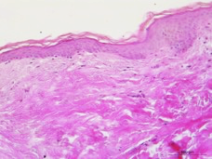
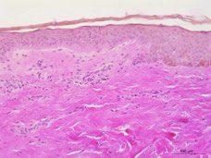
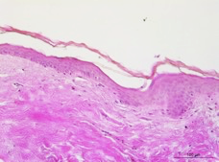
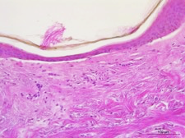
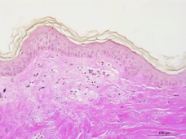
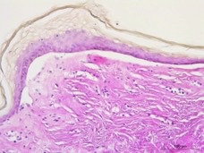
DESTRUCTURING OF THE BASAL LAMINA
Untreated
Protease digestion
Day 0
Day 3
Partial separation of the epidermis and dermis
Day 7
Complete separation of the epidermis and dermis
+Alteration of the dermis
+Loss of viability
Day 3
Day 7
21

Slide 22
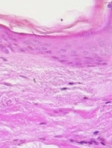
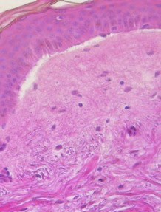
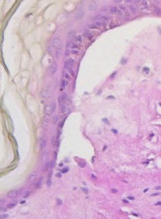
DESTRUCTURING OF THE BASAL LAMINA
Focus on the altered JDE
Day 0
Day 3
Day 7
22
Notes:
Alteration too strong at D7
Suffering tissue

Slide 23
VALIDATION & PRODUCT EVALUATION
D-3
D0
D3
+/- Pretreatment with
tested product
+/- Treatment with
tested product
Digestion of
Collagen IV
Collection
Analysis of the 3 collagens of the basal layer:
Collagen IV
Collagen VII
Collagen XVII
Analysis of the collagen of the dermal matrix:
Collagen I
23
Notes:
These are the results we have so far and we are currently pursuing our research in parallel with the development of a new cosmetic active ingredient.

Slide 24
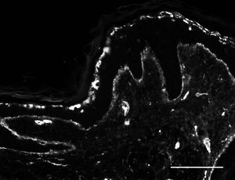
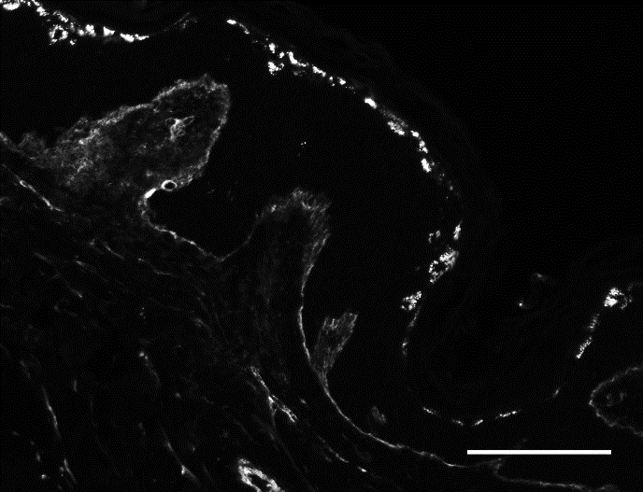
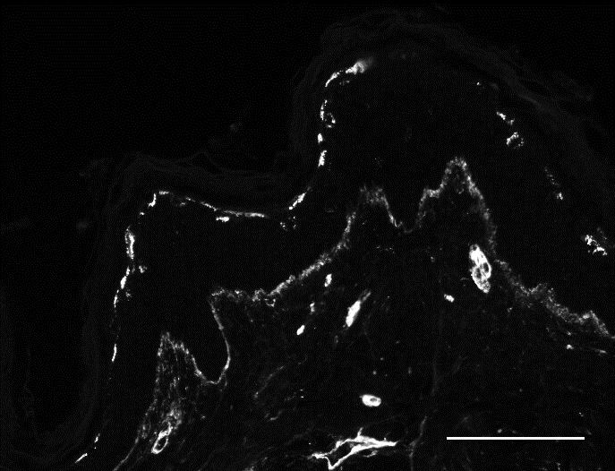
BIOMARKERS OF THE BASAL LAMINA
COLLAGEN IV
Protease
+ product
Untreated
Protease
Recovery of
Collagen IV expression
24
Notes:
Décrire les images
Quantification in the DEJ
Collagen is the specific target
Partiel digestion in order to be able to quantify a reverse effect

Slide 25
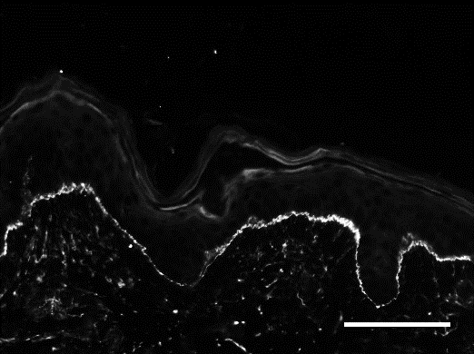
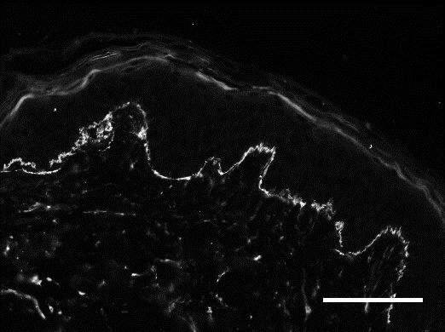
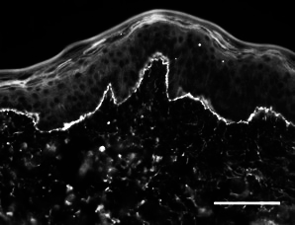
BIOMARKERS OF THE BASAL LAMINA
COLLAGEN VII
Protease
+ product
Untreated
Protease
Slight increase of
Collagen VII expression
25

Slide 26
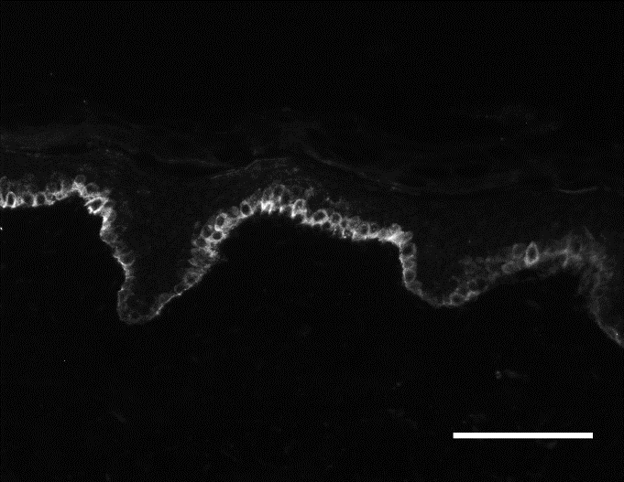
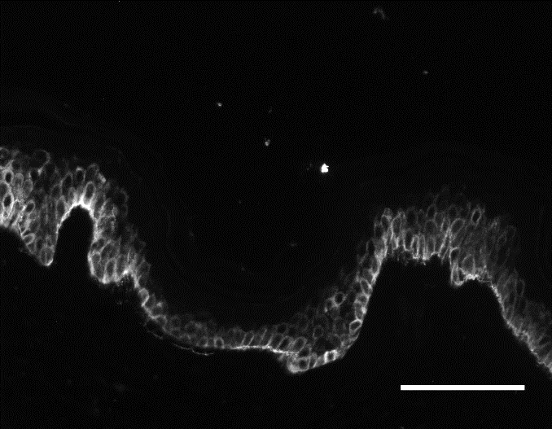
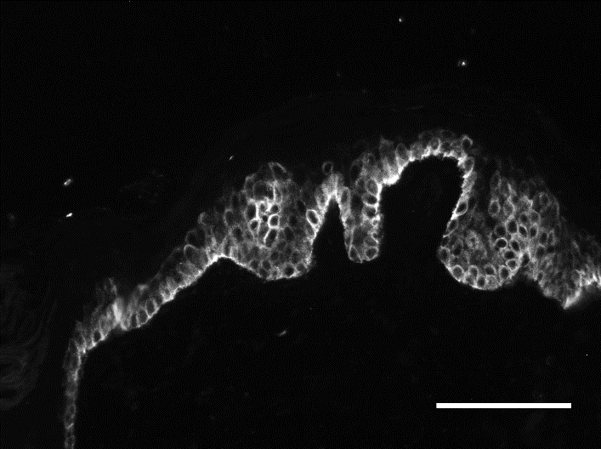
BIOMARKERS OF THE BASAL LAMINA
COLLAGEN XVII
Protease
+ product
Untreated
Protease
Slight increase of
Collagen XVII expression
26

Slide 27
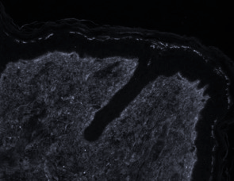
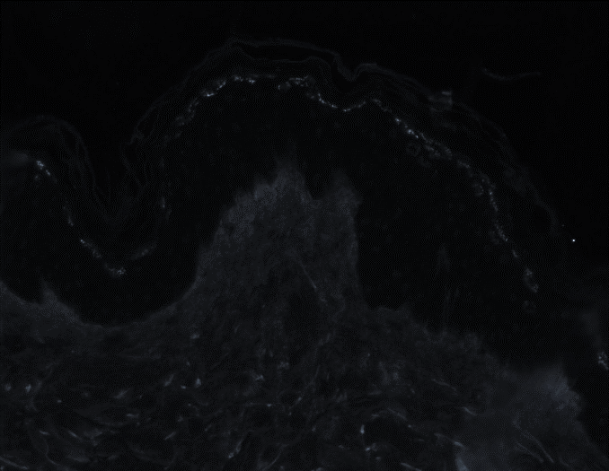
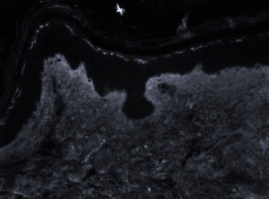
BIOMARKERS OF THE DERMAL MATRIX
COLLAGEN I
Protease
+ product
Untreated
Protease
Partial recovery of
Collagen I expression
27
Notes:
Collagen I is the secondary target of the protease

Slide 28
ALTERED MATRIX MODEL
D0
D3
D5
Digestion of
Collagen I
Collection
Collection
Explant immersed in the medium containing the specific enzyme
Rinsing
Embedded in a nourishing matrix for culture and treatments

Slide 29
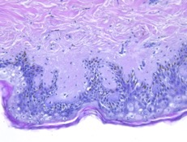
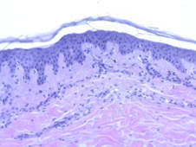
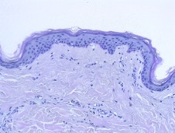



DESTRUCTURING OF DERMAL MATRIX
Untreated
Protease digestion
Day 0
Day 3
Day 3
Partial alteration of the dermis
Day 7
Strong alteration of the dermis
+Loss of viability
Day 5
29
Notes:
Validation of the decrease in the expression of Collagen I: -50%.

Slide 30

VALIDATION & PRODUCT EVALUATION
D0
D3
+/- Treatment with tested product
Digestion of
Collagen I
Collection
Analysis of the collagen of the dermal matrix:
Collagen I
Evaluation of increasing doses of product
30
Notes:
These are the results we have so far and we are currently pursuing our research in parallel with the development of a new cosmetic active ingredient.

Slide 31










COLLAGEN I ANALYSIS
Collagenase
+ product placebo
Collagenase
+ product 1%
Collagenase
+ product 2%
Untreated
Collagenase
Recovery of Collagen expression
Dose effect
Clinical trial ongoing…
31

Slide 32






SUMMARY
Physiological response close to in vivo
Accelerated ageing
➔ Short times of evaluation
➔ Quick response
Relevant results
Possibility to develop targeted ageing models
➔ for specific claims (ECM, Hair, Hypodermis...)
High predictive value
Specific skin models
Clinical tests
Notes:
Much remains to be done on these models, but we are continuing our research.

Slide 33

CONCLUSION
Today’s claims need more than a corneometer study on 3 lab technicians…
EVIDENCE BASED COSMETICS require careful choice of tools, protocols, material…
In vitro and ex-vivo studies help to guide the investigator for clinical trials which are the GOLD standard

Slide 34


Slide 35

Thank you for your attention
Thanks to our team
CENTRE PIERRE POTIER
1 Place Pierre Potier
Oncopôle
Entrée B - BP50624
31106 TOULOUSE Cedex 1
Tél : +33 974 770 660
Fax : +33 974 770 669 ww.syntivia.fr

