Slide 1
People Development Summit
3-4 February 2020, Habtoor Grand, Dubai

Slide 2
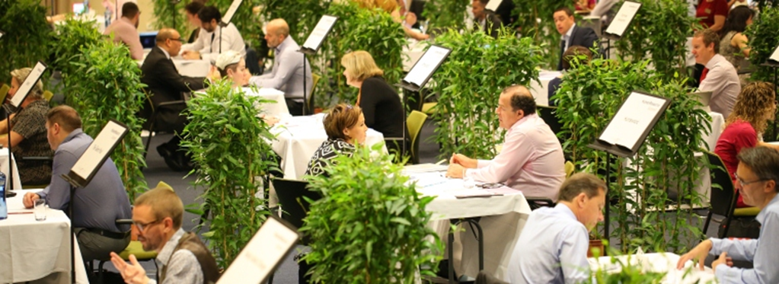
About the Summit
How will you benefit? - network and share best practice with peers
- business ‘speed dates’ with top solution providers - hear from leading speakers on hot HR topics - take part in strategy sessions and round table discussions
- informal networking opportunities during coffee breaks, lunches and the evening cocktail reception The Summit is designed to be a relaxed and time effective way to discover what’s new in the market place and source partners for upcoming projects.
Our London based company, Summit Events, has been running high quality HR b2b networking events for the UK/European market for over 25 years. We brought the same successful formula to Dubai in February 2019.
The Summit is an exclusive ‘invitation only’ event reserved for senior HR decision makers and budget holders looking to discover the latest people development solutions and network with likeminded peers.

Slide 3
Audience
HR buyers
60 senior HR professionals representing top corporations from the Middle East and Africa. Job titles will include:
Sponsors
25 HR solution providers including; top business schools, innovators in leadership and talent management, employee engagement & retention specialists and HR systems & technology specialists.
Head of/Director of HR
Head of/Director of Talent, Learning & Development
Head of/Director of Organisational Development
2020 headline sponsors:
Key clients:

Slide 4
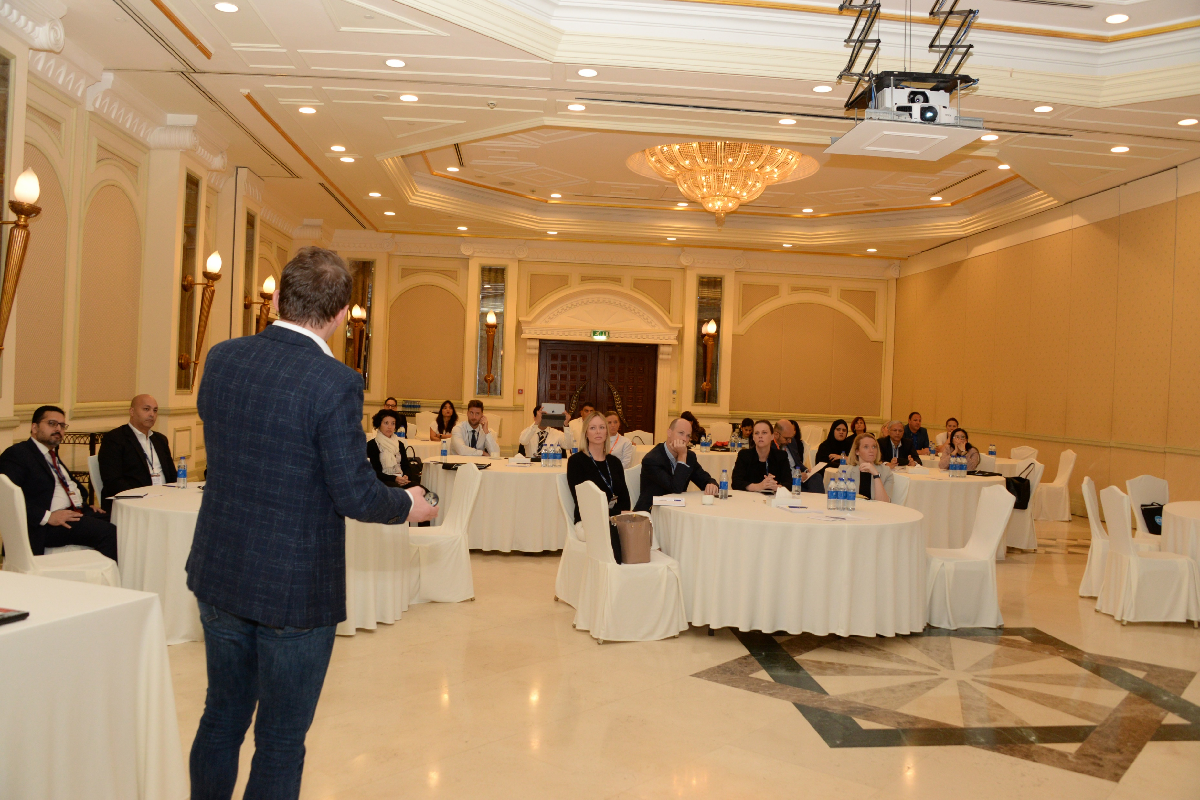
2020 Programme
The speaker programme for the event includes: - Keynotes - 2 high profile speakers sharing latest HR innovations will open the Summit each day - Strategy Group sessions - 5 one hour breakouts facilitated by senior HR practitioners sharing case studies, with real-business examples of challenges, failures and successes, giving participants useful take-home data and expertise - Action Learning workshops – 2 round table topic-driven and interactive workshops
Topics will include:
Driving change as an employee engagement rebel
Mobilising others through nudges
Leveraging Technology to reinvent People Experience
Mapping the experience of employees throughout their life cycle
Turnaround business through Performance Culture
Selecting an HR information system that’s right for YOUR organization
Change and disruption in HR
Do we need to help our teams digitally detox?
Understanding lasting culture change
If you have suggestions for topics or speakers, or are interested in speaking yourself, please contact georgina.kelly@summit-events.com

Slide 5
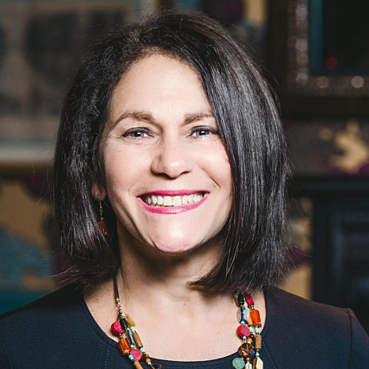
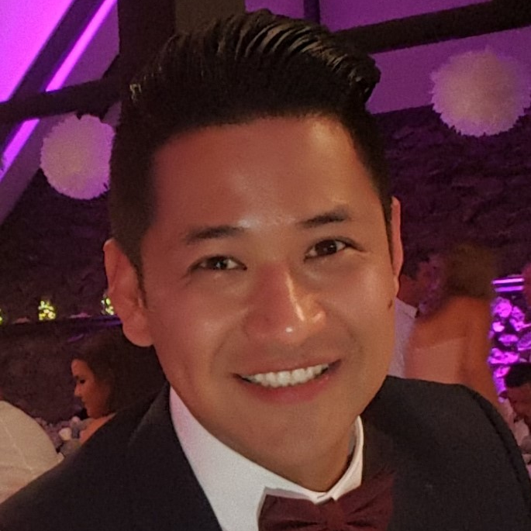
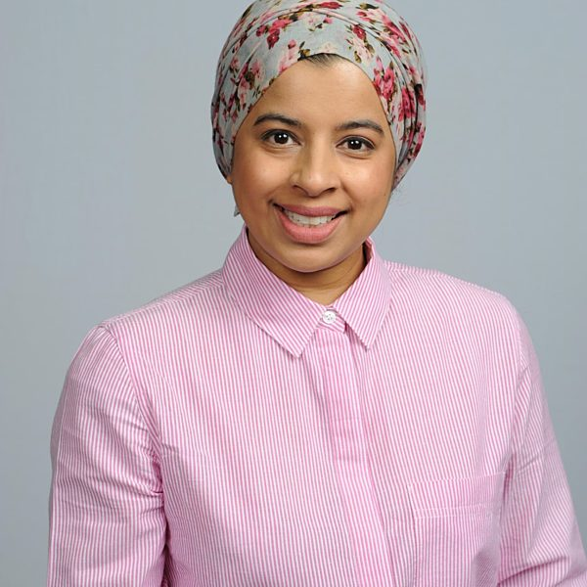
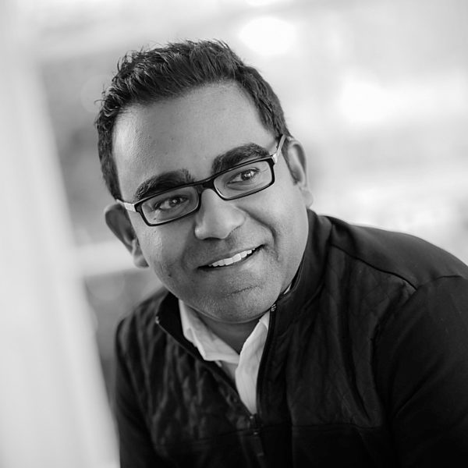
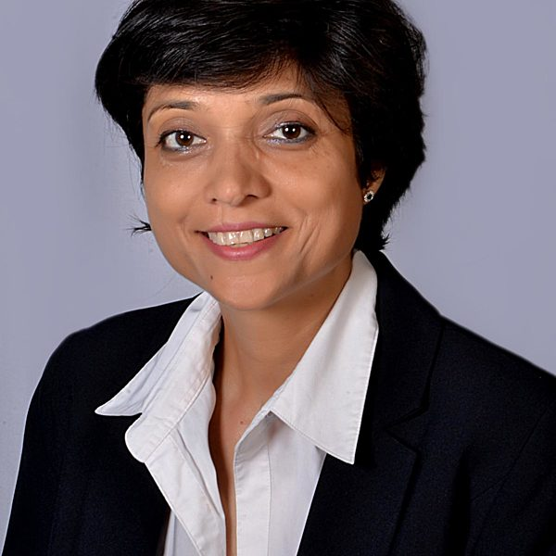
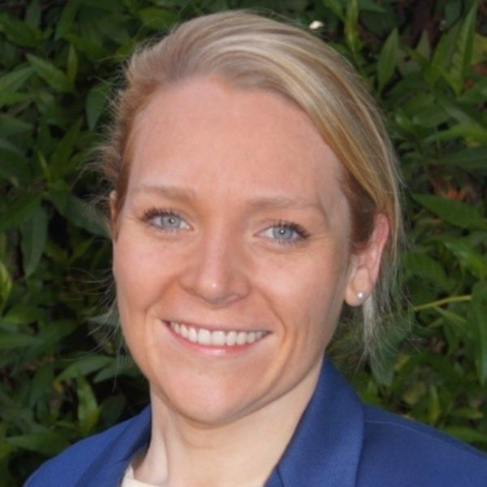
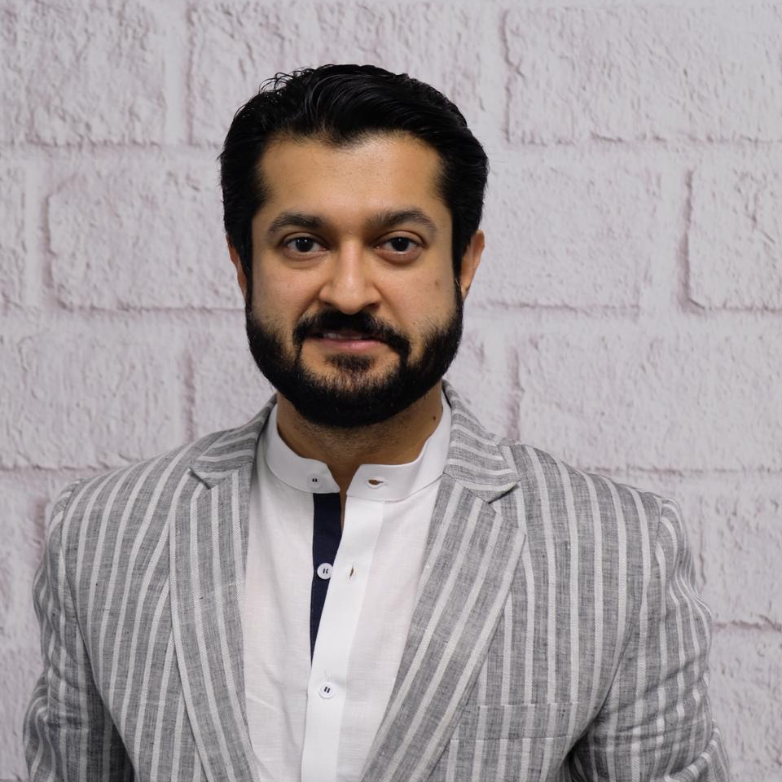
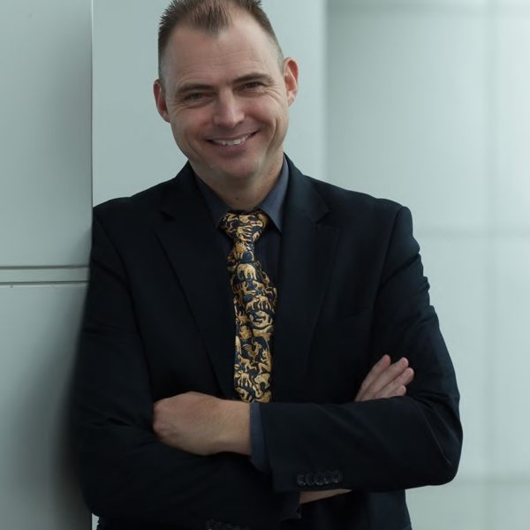
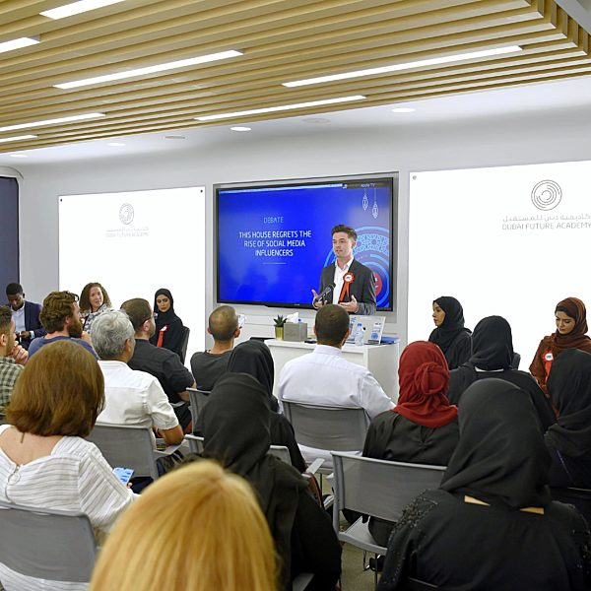
2020 speakers
The programme is currently being finalised. Below are our confirmed speakers:
Debra Corey
Speaker, Author and Chief Pay it Forward Officer
DAY 1 KEYNOTE
Florencio Padilla Head of People Experience – Group HR
Chaloub Group
STRATEGY SESSION
Toneya Sarwar
Head of HR Middle East & Africa CISCO
STRATEGY SESSION
Niro Sivanathan
Associate Professor of Organisational Behaviour London Business School
DAY 2 KEYNOTE
Nishi Shetty
People Transformation Strategist
STRATEGY SESSION
Kate Brenton
Senior Talent & Development Manager Delta Partners
ACTION LEARNING WORKSHOP
Aseem Kapoor
Corporate Director Human Resources Emaar Group
STRATEGY SESSION
Marc Roos
Divisional Leader, Oil & Gas, DISCOVERY programme The Weir Group
STRATEGY SESSION
Debate Mate
CLOSING PLENARY

Slide 6
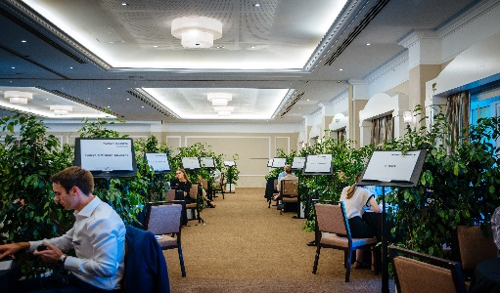
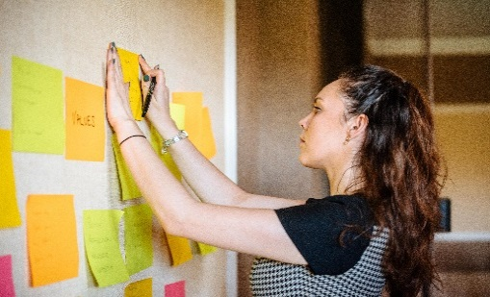
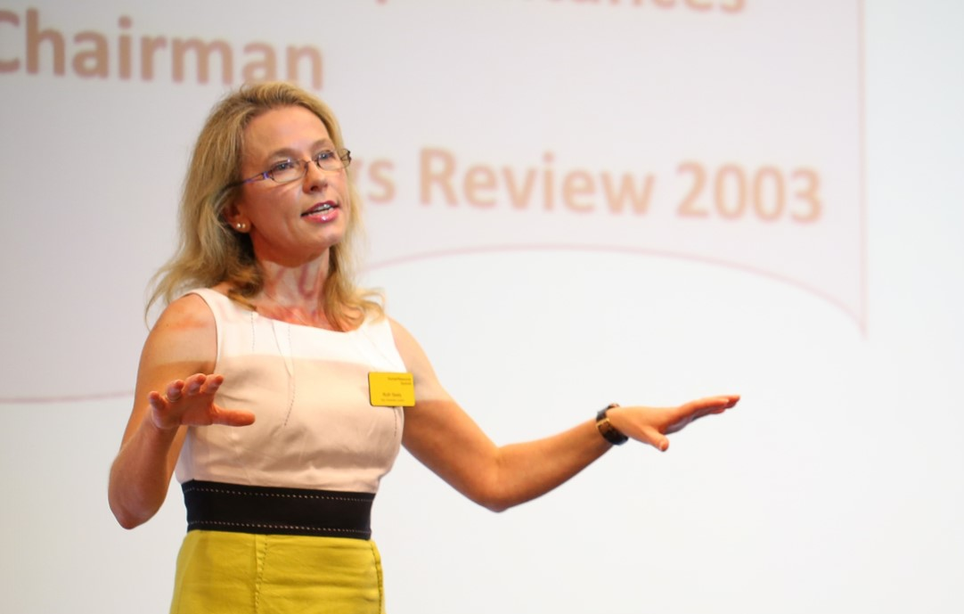
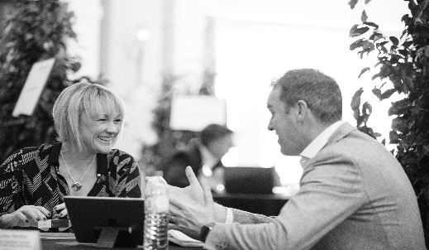
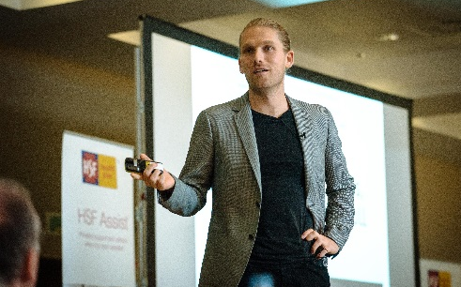
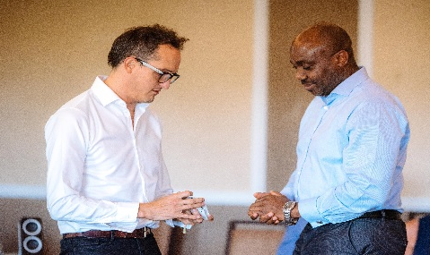
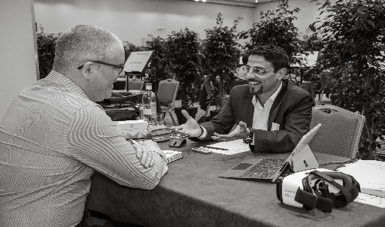
Why you should take part
Time saving
Two consolidated days in which to meet a range of new HR vendors offering business solutions - all in one place
Learn, discover Gain thought-provoking insight, practical solutions and quality time with top-level contacts from top MENA brands
It’s free!
If you’re a senior HR decision maker and budget holder there is no charge to attend
Network!
Meet and network with other Heads of HR, sharing ideas and best practice, and develop long-lasting relationships with your peers
Personalised Tailor your experience with a personalised agenda ensuring that every moment on-site will reflect your company's upcoming needs and interests
The Summit experience
Our team work tirelessly to create the perfect environment to ensure all our attendees get a high-quality personalised experience
Promote your learning solutions
As a sponsor you will benefit from a set number of set number of face to face meeting with engaged and qualified senior HR buyers
Convenience
Via our online event dashboard, you will have access to detailed profiles of attendees from which to pre-select your best prospects and the sessions you’d like to attend
.

Slide 7
Hear it from others…
Summit Events are based in London and have been organising sector leading industry networking events for over 25 years. Our aim is to provide a high-quality, personalised service to our clients, and ensure that they get the maximum value from each event. We are proud of our reputation and the long term relationships we have built through our consistent service.
“The interaction with fellow professionals was a key factor in attending and meeting with potential partners gaining insight into their areas of expertise was invaluable. Some great keynote presentations and workshops that were both relevant and aligned with my interests and needs.”
Gary Hazel, Head of Learning & Development, Injazat Data Systems
“A very well organized event bringing together switched-on delegates and interesting suppliers. A very personalized experience in contrast to the huge impersonal expos we often have here in Dubai.”
Paul Turner, Regional Director MENA, Havas People
“My favourite Summit event so far. The event was impeccably organised, as ever, but this really felt like you were part of something special. Quality delegates, quality suppliers, very professionally run and the atmosphere was focussed, friendly and very enjoyable.”
Eric Gresswell, Director, Popcorn Learning Media
“The event was very well organized in a way that kept us busy, learning and networking at the same time. I would highly recommend this event for L&D Decision makers in any type of industry!”
Carole Keyrouz, Training Manager, Marriott Hotels International Limited
Please follow this link to read all feedback for PDS19 - Dubai
Please contact us if you would like us to arrange a referral from any of our past vendor or delegate attendees; we will be more than happy to put you in touch. Read past participant testimonials or visit our Vimeo page to see footage from recent events

Slide 8
What's the cost?
If you are a senior Head of HR, Learning & Development or equivalent, there is no charge to attend. Your delegate place includes lunches & refreshments, the only cost to you is your time out of the office.
In advance of the Summit you will pre-select the sessions and vendors that are of interest and, based on your preferences, we’ll create your personalised schedule.
Is the Summit right for you?
For the Summit to work for you, you must feel comfortable with the following selection criteria:
You are a main HR decision maker for your organisation and directly influence strategy at a divisional or group level
You personally control a significant HR budget (this level of budget will normally relate to employee numbers in excess of 500)
You have a need to meet a number of service providers that are relevant to your business needs during the Summit in a 1-2-1 meeting format
You are able to take 2 days out of a busy schedule to attend. The results will be worth it!
The Summit experience inspiring speakers, industry insights and one to one networking with hand-picked vendors

Slide 9
Sponsor packages
Showcase your products, technologies or services with our array of sponsorship opportunities to maximise your exposure
Bronze sponsor
10 pre-arranged one to one
meetings with HR buyers
Access for one representative to attend the Summit
Additional opportunities during networking lunch on 3rd and 4th Feb
Invitation to networking drinks reception held at the hotel 17:30-18:30 3rd Feb
Contact details for all attendees
Silver sponsor
12 pre-arranged one to one meetings with HR buyers
Access for two representatives to attend the Summit
Additional opportunities during networking lunch on 3rd and 4th Feb
Invitation to networking drinks reception held at the hotel 17:30-18:30 3rd Feb
Contact details for all attendees
Additional 2-day visitor pass
Gold sponsor
15 pre-arranged one to one meetings with HR buyers
Access for two representatives to attend the Summit
Headline sponsor option – e.g. lunch, delegate bags, drinks reception, bag inserts
Corporate Logo included on all pre-event e-marketing
Additional opportunities during networking lunch on 3rd and 4th Feb
Invitation to networking drinks reception held at the hotel 17:30-18:30 3rd Feb
Contact details for all attendees
Prominent position on our website
Additional bespoke social media coverage
2 x additional 2-day visitor pass
USD 6,995
USD 10,995
USD 12,995
Please note:
20% VAT is applicable to all UK registered companies
Visitor passes also available – contact georgina.kelly@summit-events for more details

Slide 10
Sponsor inclusions
Pre-event benefits Your corporate logo and web link published on the Summit Events website Announcement on our PD Summit LinkedIn group (1000+ members) and twitter feed Access to the event dashboard where full details of HR buyers' responsibilities, business priorities and budgets are visible Your personal and company biography published online and promoted to all HR buyers Details of which HR buyers have requested a meeting with you Your provisional meetings schedule available for approval 1 week prior to the Summit | At-event benefits Your final meeting schedule Onsite support from your Summit Events account manager Possibility of additional ‘ad hoc’ meetings Your private meeting area including table, chairs, power supply, company name signage Soft and hard copy of all the HR buyer, vendor and speaker profiles – not just the ones your company is scheduled to meet Full page profile in the event programme Access to keynote presentations and breakout sessions All meals & refreshments which form part of the event schedule | Post-events benefits Once the post event survey is completed we will provide you with feedback/comments from the HR buyer you met at the event regarding your meeting and instructions for follow-up The event website will contain and maintain the same level of branding for up to 6 months after the event Support from Summit Team with post-event follow up
Get involved
www.summit-events.com
+44 (0)20 7828 2278
eventteam@summit-events.com
#PDSdubai20 @DubaiSummit @SummitEvents

